Slide 1
Guided Project I
UNDERSTANDING STUDENT SATISFACTION
A FIRST-YEAR FEEDBACK ANALYSIS
05 June, 2025

Slide 2

HELLO!
Warm greetings to all present. The reason why I chose this topic for the project was because it was going to be very relatable as a student myself. The aim is to understand why some students enjoy their first year while others struggle - despite the same inputs in faculty, resources, and schedule.
ananyalytics@gmail.com

Slide 3
GOAL
PROBLEM STATEMENT
PROJECT OBJECTIVE
Many first-year students have different experiences at college – some love it, others struggle. But what exactly drives student satisfaction, and how can we improve it?
To collect and analyze the feedback from first-year students to identify key factors that affect their satisfaction and recommend practical improvements.

Slide 4
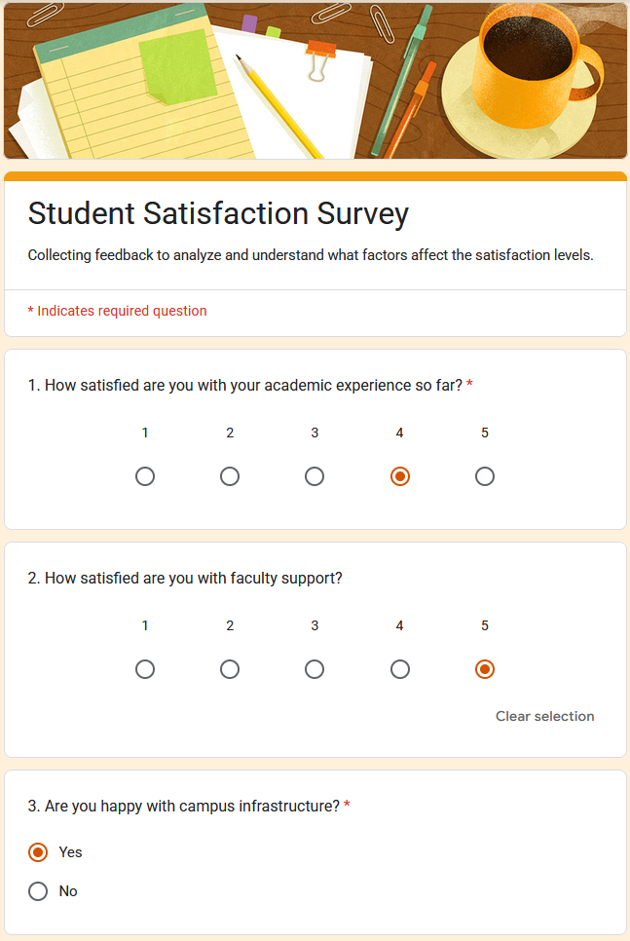
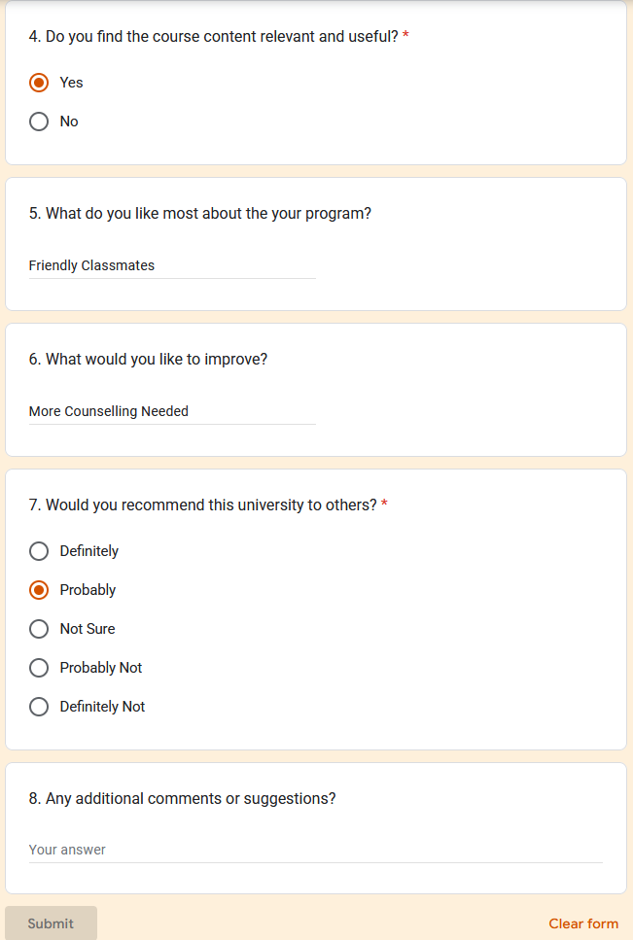
GOOGLE FORMS
SURVEY

Slide 5
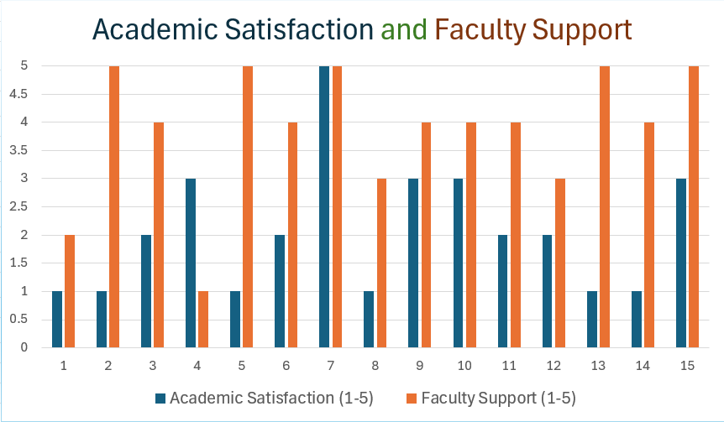
DATA ANALYSIS
The given bar-chart dashboard shows the students satisfaction level with the Academics and Faculty Support.

Slide 6

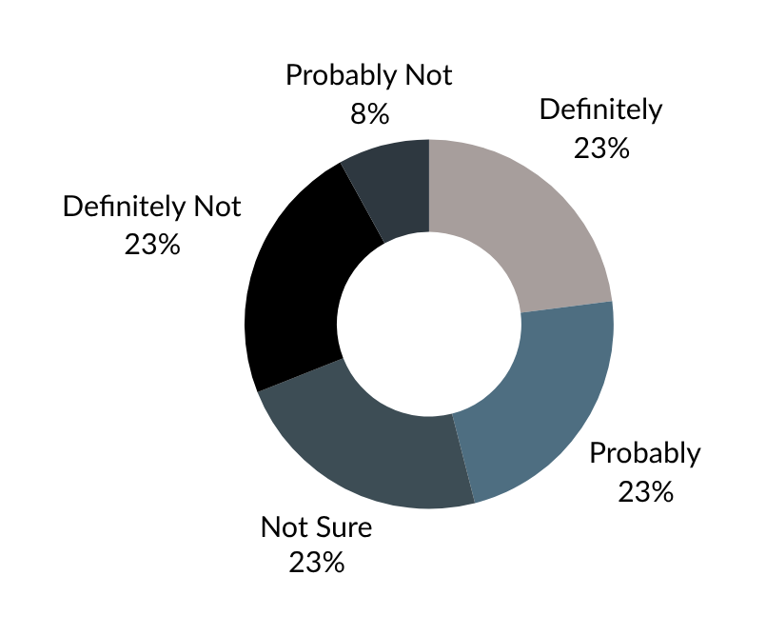
UNIVERSITY RECOMMENDATION
Here’s an INTERACTABLE DASHBOARD visualizing how likely are the students to recommend this university to others..

Slide 7
DATA INSIGHTS
Here’s are some insights gathered from the analyzed data:
01
02
03
WHAT ARE STUDENTS MOST HAPPY WITH?
WHAT AREAS NEED IMPROVEMENT?
ANY COMMON THEMES OF PRAISE OR COMPLAINT?
77% of the students are satisfied with faculty support, & 73% with the university’s infrastructure.
Only 41% of the students are satisfied with their academics and only 47% of students found the course content to be relevant.
Common praises: friendly classmates, helpful seniors, good college events. Common complaints: lack of counseling, high academic pressure.

Slide 8
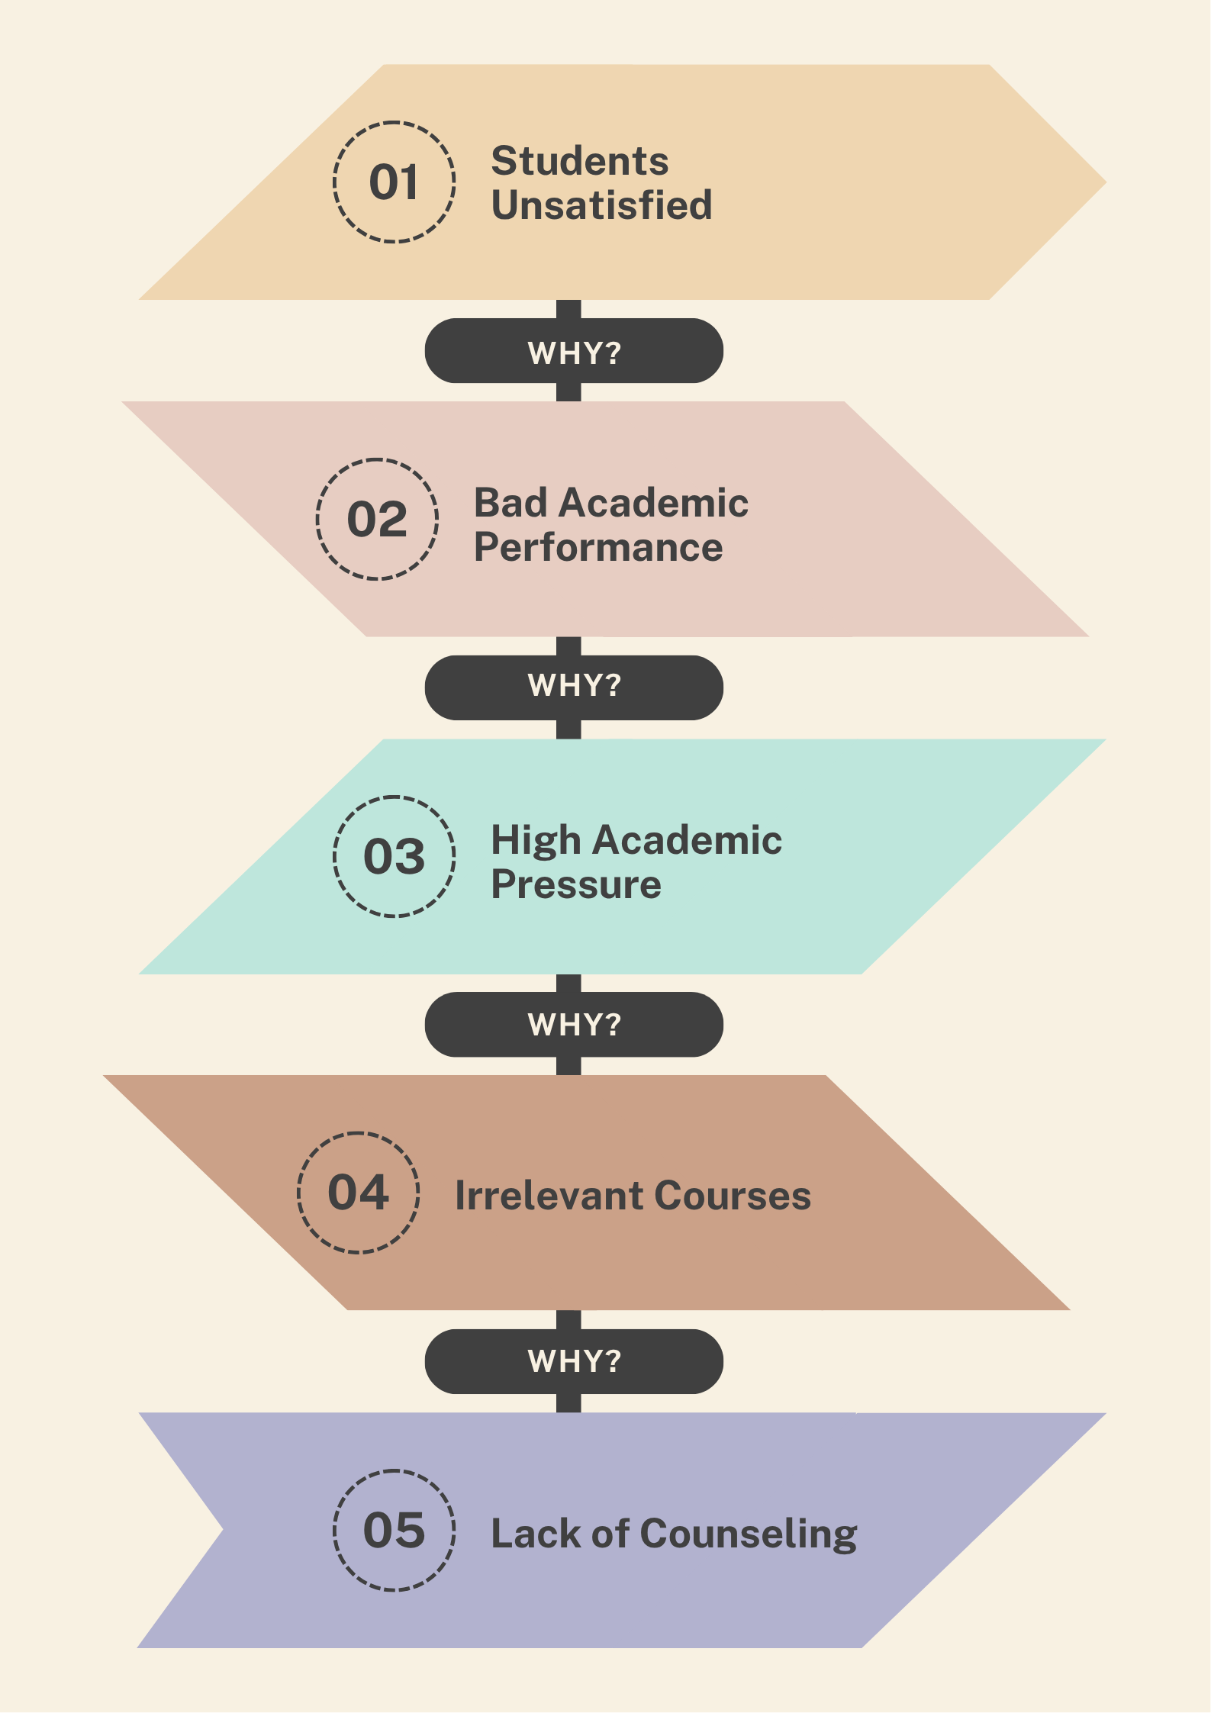
ROOT CAUSE ANALYSIS
From the patterns observed, academic dissatisfaction emerged as the primary issue. The root cause analysis outlines the contributing factors.
STEPS FOR IMPROVING STUDENTS’ ACADEMICS
1. Recruiting more counselors to:
a. Help Students handle academic pressure &
b. Understand the relevant courses for them.
2. As per recommendations, more college events need to be introduced so that the students don’t get overwhelmed with academics.

Slide 9
PROJECT REFLECTION
This was my first guided project, and the experience helped me significantly in understanding and applying the role of a Business Analyst. With step-by-step support from ChatGPT, I was able to navigate through stage confidently. The guidance included helping me design the survey, generating mock responses for 15 students, and offering direction whenever I felt stuck or unsure about the next step.

